Slide 1
Object Oriented Programming
Demonstration of viruses
structure and its mechanism
Professor: PhD Nguyen Thi Thu Trang
Teaching Assistance: Nguyen Thi Minh Chau
Group 4: Tran Thai Phuc – 20184300
Nguyen Trong Nghia – 20184297
Nguyen Trinh Vu - 20184332

Slide 2
Member & Assignment
Tran Thai Phuc – 20184300
- Designing class diagram, slice
- Writing source code: package oop.globalict.project.gui
- Investigating virus-structure
Nguyen Trong Nghia – 20184297
- Designing use-case diagram, writing report
- Writing source code: Package oop.globalict.project.virus, oop.globalict.project.storage
- Investigating virus – infection progress
Nguyen Trinh Vu – 20184332
- Designing class diagram, slice
- Writing source code: package oop.globalict.project.gui
- Take demo video

Slide 3
Problem statement
Overview: COVID-19 has been spreading all over the world and there is the need of understanding different type of viruses, as well as their infection progress.
Requirement: design an application using JavaFX for showing virus’s structure and the progress of virus infecting the host cell.

Slide 4
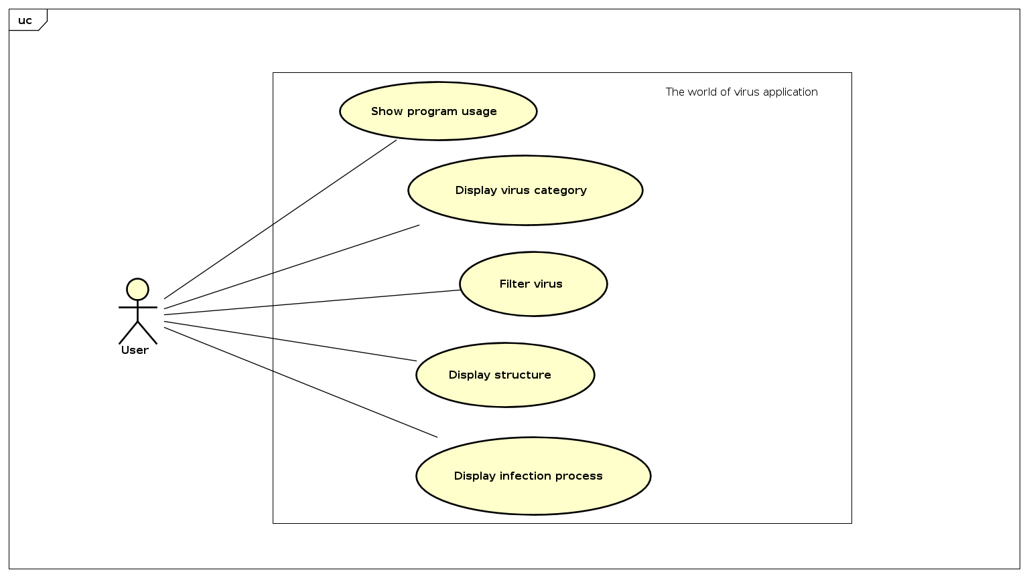
Use-case diagram

Slide 5
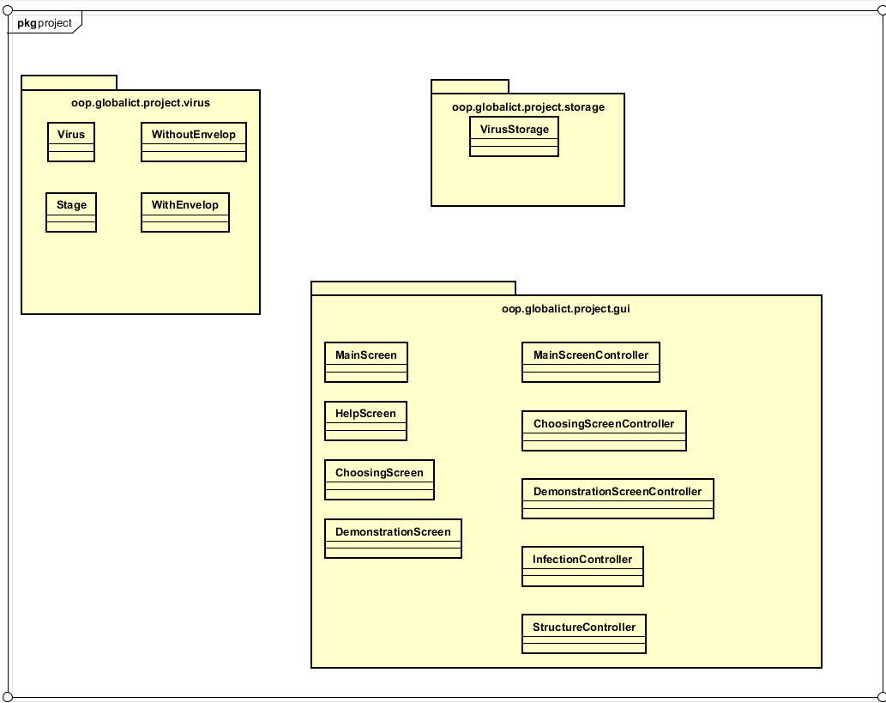
general Class diagram

Slide 6
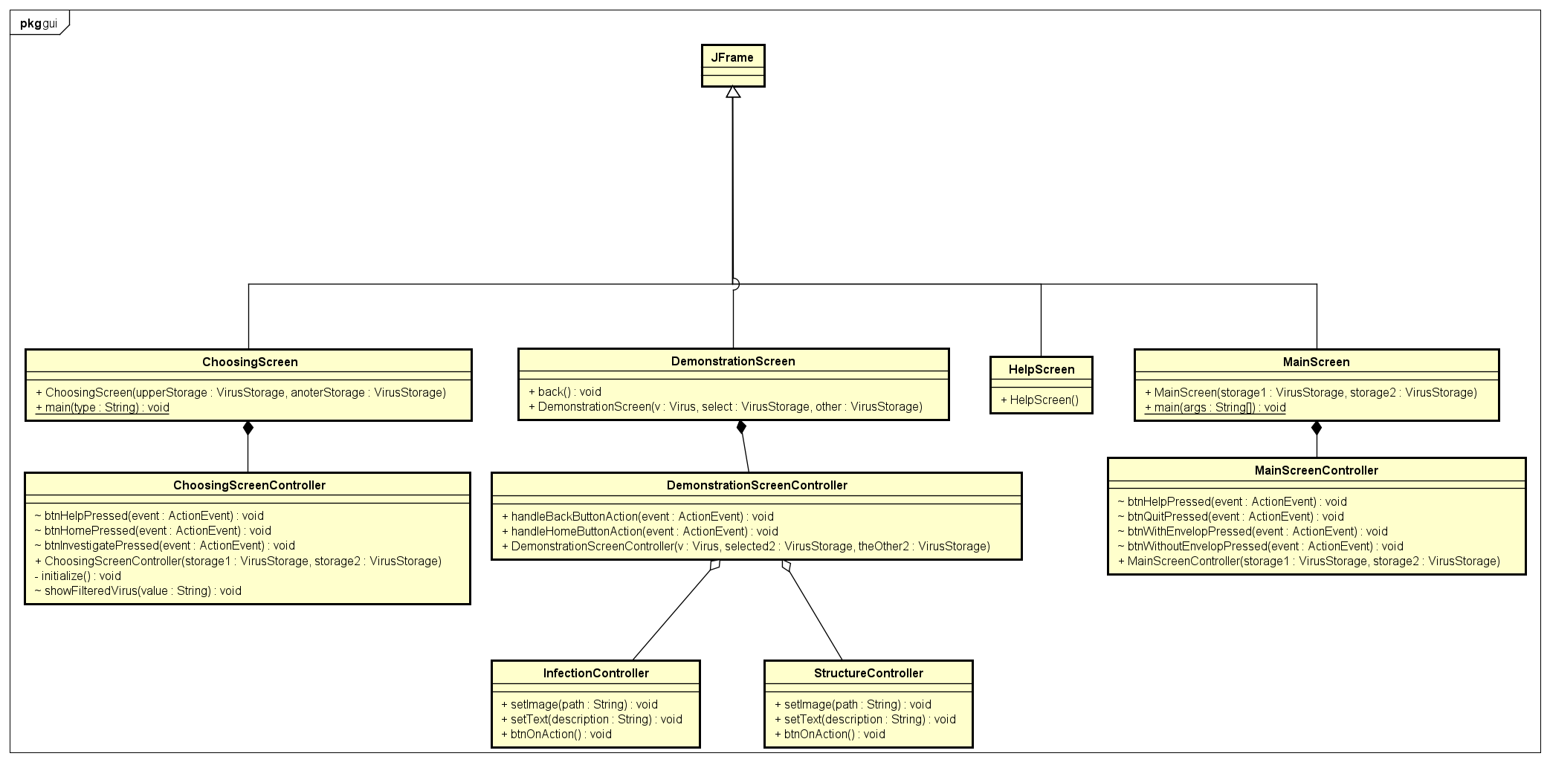
Class diagram for packages
Package oop.globalict.project.gui

Slide 7
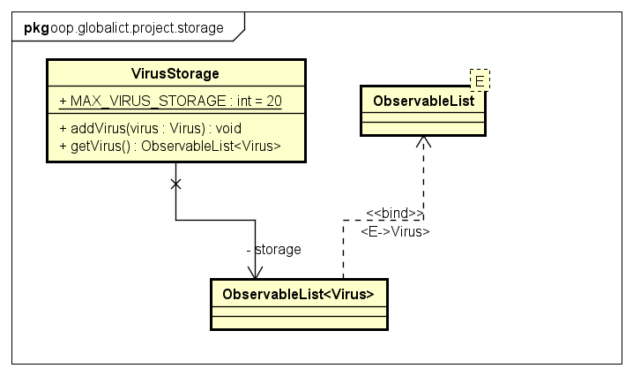
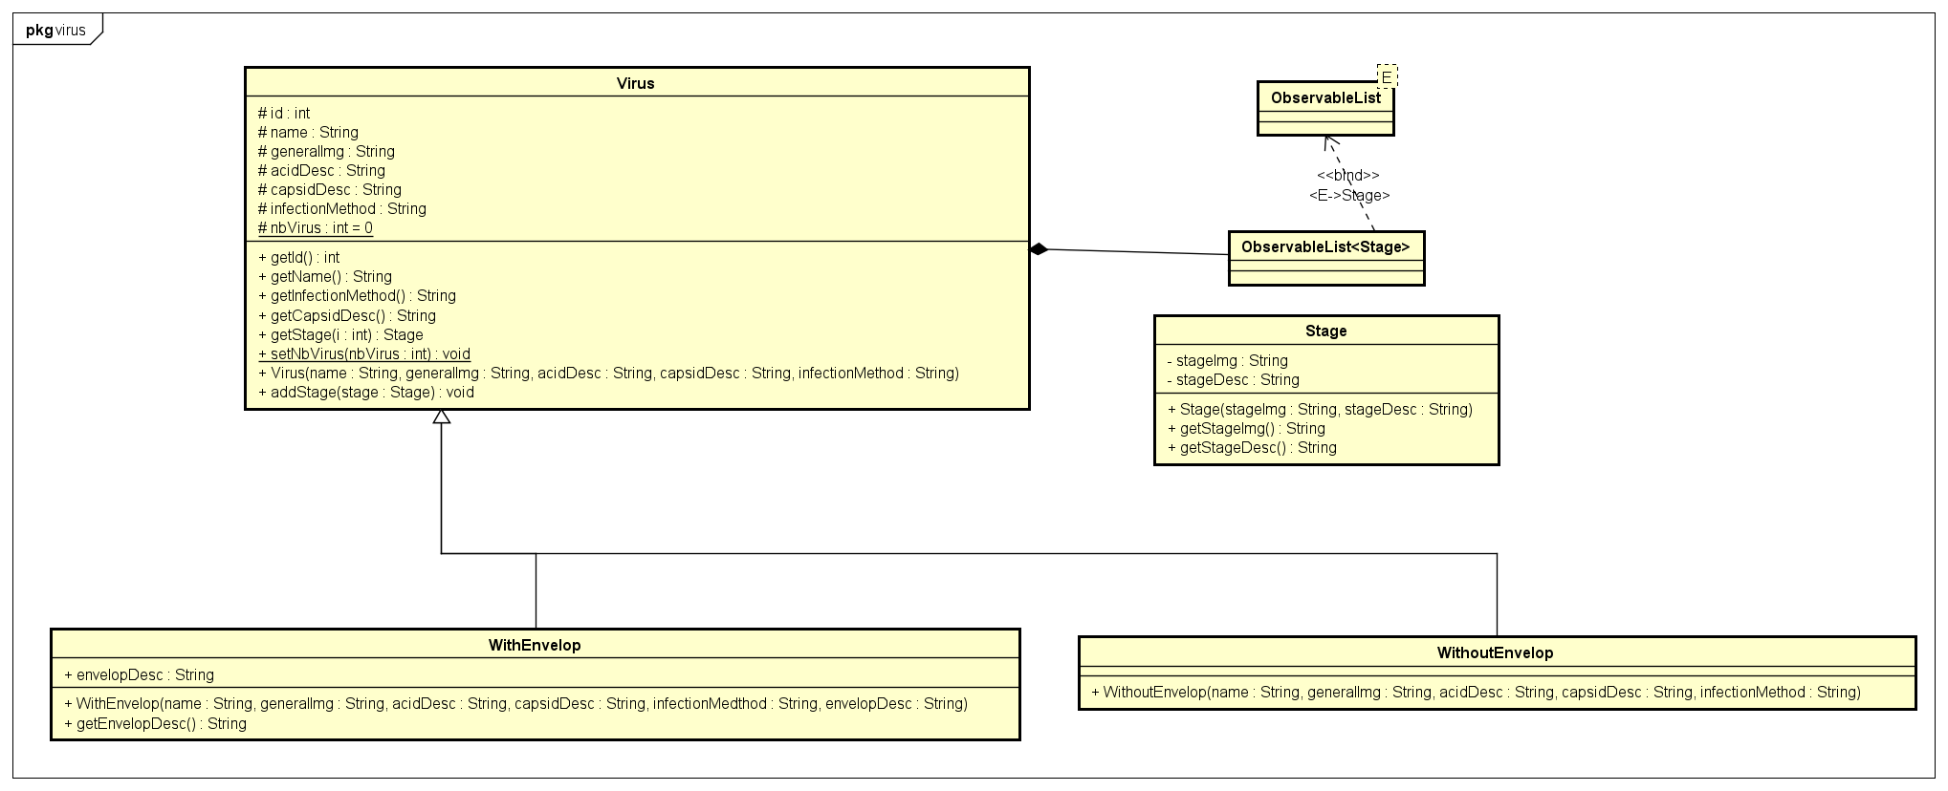
Class diagram for packages
Package oop.globalict.project.virus
Package oop.globalict.project.storage

Slide 8
Explanation of oop technique
1. Virus package
2 classes WithEnvelop and WitoutEnvelop are inherited from class Virus. (Inheritance)
Class Virus contains an observable list of Stage (Composition)
2. Storage package
There is only 1 package VirusStorage, it’s a list to contain several typical viruses.
3. GUI package
4 classes: MainScreen, DemonstrationScreen, HelpScreen, ChoosingScreen are inherited from Jframe.
Each of 4 classes has its controller class (Composition)
Demonstration has a StructureController and an InfectionController (Aggregation).

Slide 9
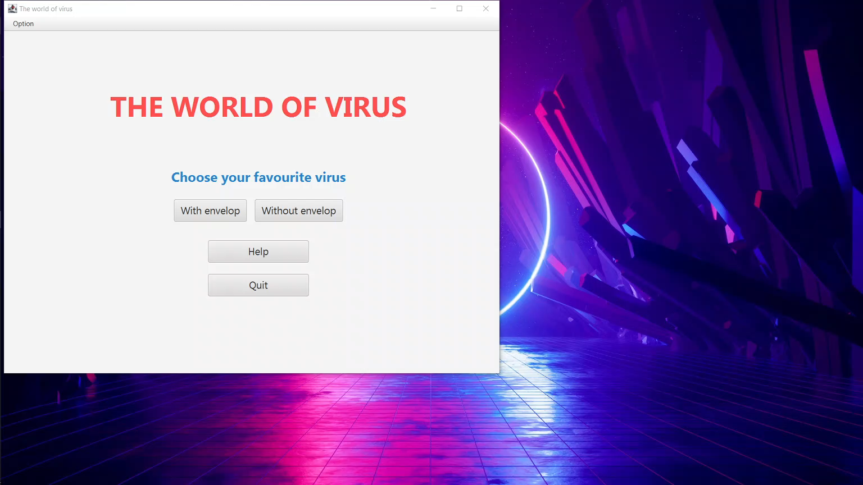
Demo videO

Slide 10
THANK YOU FOR LISTENNING

